Slide 1
AIFA Assignment 1
Manishka Mukhopadhyay - 20IM10022
Oindrila Maji - 20IM30013
Ronit Wanare - 20IM30027
Kshamit Bombarde - 20BT3AI07

Slide 2
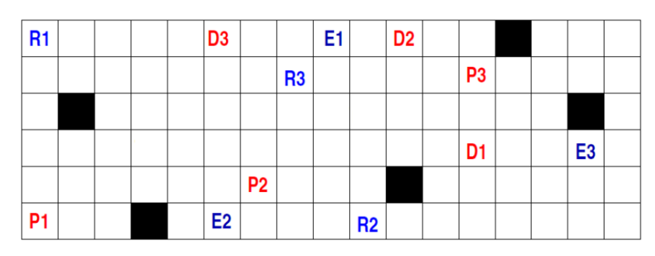
Problem Statement: Multi Agent Path Finding
A certain shop floor is represented as a 2-D grid of size n x m, as shown in the figure below. In the shop floor, robots are employed to perform shipment tasks, where a task involves shipping a component from a designated pick-up cell location to a destination cell. There are ‘k’ robots and ‘k’ shipment tasks. Each robot performs a single task. A robot can move at most one cell (either vertically or horizontally) at a time step. A cell cannot be simultaneously occupied by more than one robot. Black coloured cells are obstacles and cannot be traversed through. All robots start at the same time. The ith robot starts from cell location Ri, picks up one the components (say) at location Pj, delivers it in cell Ej and finally moves to cell Di. The objective is to choose the appropriate task for each robot and determine its corresponding travel path, so that overall completion time for the work schedule involving all tasks is minimized.
The figure can be defined as :
grid size = (6,17)
obstacles = [(1,14), (3,2), (3,16), (5,11), (6,4)]
starts = [(1,1), (6,10),(2,8)]
pickups = [(2,13), (5,7), (2,13)]
deliveries = [(4,13), (1,11), (1,6)]
ends = [(1,9),(6,6), (4,16)]
Solution Approach:
We implement the A* (A-star) algorithm on python for pathfinding in a grid environment with multiple agents.

Slide 3
Node Class: The 'Node' class represents a node in the grid and includes data about its position (x, y), a reference to its parent node (to be used for path reconstruction), and the three variables 'g', 'h', and 'f'. 'g' stands for the cost from the start node to the current node, 'h' is the heuristic estimate of the cost from the current node to the target node, and 'f' is the total estimated cost (='g + h') used to prioritise nodes in the A algorithm.
Heuristic (estimate_heuristic) Function: The `heuristic` function calculates the Manhattan distance between a given node and the goal node and is used to estimate the remaining cost from a node to the goal.
A* Algorithm (astar_search): The `A star` function implements the A algorithm. It takes the grid, start position, and goal position as input and returns the path from the start to the goal. The algorithm uses a priority queue (`open_list`) to keep track of open nodes and a set (`closed_list`) to store closed nodes, i.e., nodes that have already been evaluated. The start node is initialized with `g`, `h`, and `f` values and it repeatedly selects the node with the lowest `f` value from `open_list`. If the selected node is the goal node, it reconstructs the path and returns it, else, it explores neighboring nodes, updates their `g`, `h`, and `f` values, and adds them to the `open_list` for evaluation. This continues until the goal is reached or all possible paths are explored.
CBS Algorithm: A root node is created with no parent or constraint. The cost (sum of path lengths) for each agent are computed. Priority ‘open_list’ is created for storing open nodes and ‘closed_list’ for closed nodes. Unlike A* algorithm, CBS breaks down the multi agent problem into multiple single agent problems. Same steps as A* are followed until all path conflicts are resolved.
detect_conflicts Function: This detects conflicts between each agents’ paths and iterates for all agents until no path conflicts exist anymore.

Slide 4
Test Case 1:
grid_size_1= (10, 10)
num_agents_1 = 3
obstacles_1 = [(1, 1), (1, 2), (1, 3), (2, 3), (3, 3), (4, 3), (5, 3), (6, 3), (7, 3), (8, 3)]
starts_1 = [(0, 0), (9, 0), (9, 9)]
pickups_1 = [(0, 9), (8, 9), (0, 8)]
deliveries_1 = [(9, 8), (8, 8), (9, 7)]
ends_1 = [(0, 7), (7, 7), (0 ,6)]
Solution by CBS : [[(0, 0), (0, 1), (0, 2), (0, 3), (0, 4), (0, 5), (0, 6), (0, 7)], [(9, 0), (9, 1), (9, 2), (9, 3), (9, 4), (9, 5), (9, 6), (9, 7), (8, 7), (7, 7)], [(9, 9), (9, 8), (8, 8), (7, 8), (6, 8), (6, 7), (6, 6), (5, 6), (4, 6), (3, 6), (2, 6), (1, 6), (0, 6)]]
Time taken by Conflict-Based Search (CBS): 0.004939556121826172 seconds
Solution by A*: [[(0, 0), (0, 1), (0, 2), (0, 3), (0, 4), (0, 5), (0, 6), (0, 7)], [(9, 0), (9, 1), (9, 2), (9, 3), (9, 4), (9, 5), (9, 6), (9, 7), (8, 7), (7, 7)], [(9, 9), (9, 8), (8, 8), (7, 8), (6, 8), (6, 7), (6, 6), (5, 6), (4, 6), (3, 6), (2, 6), (1, 6), (0, 6)]]
Time taken by A* Algorithm: 0.0019071102142333984 seconds
Test Case 2:
grid_size_2 = (5, 5)
num_agents_2 = 3
obstacles_2 = [(1, 1), (1, 2), (1, 3), (2, 3), (3, 3), (4, 3)]
starts_2 = [(0, 0), (4, 0), (4, 4)]
pickups_2 = [(0, 4), (3, 4), (0, 3)]
deliveries_2 = [(4, 2), (3, 2), (4, 1)]
ends_2 = [(0, 2), (2, 2), (0 ,1)]
Solution by CBS : [[(0, 0), (0, 1), (0, 2)], [(4, 0), (4, 1), (3, 1), (2, 1), (2, 2)], [(4, 4), (3, 4), (2, 4), (1, 4), (0, 4), (0, 3), (0, 2), (0, 1)]]
Time taken by Conflict-Based Search (CBS): 0.0028913021087646484 seconds
Solution by A*: [[(0, 0), (0, 1), (0, 2)], [(4, 0), (4, 1), (3, 1), (2, 1), (2, 2)], [(4, 4), (3, 4), (2, 4), (1, 4), (0, 4), (0, 3), (0, 2), (0, 1)]]
Time taken by A* Algorithm: 0.0012669563293457031 seconds

Slide 5
Test Case 3:
grid_size_3 = (20, 20)
num_agents_3 = 2
obstacles_3 = []
starts_3 = [(0, 0), (3, 3)]
pickups_3 = [(0, 3), (3, 0)]
deliveries_3 = [(1, 3), (2, 0)]
ends_3 = [(2, 3), (1, 0)]
Solution by CBS : [[(0, 0), (0, 1), (0, 2), (1, 2), (2, 2), (2, 3)], [(3, 3), (3, 2), (2, 2), (1, 2), (1, 1), (1, 0)]]
Time taken by Conflict-Based Search (CBS): 0.0014407634735107422 seconds
Solution by A*: [[(0, 0), (0, 1), (0, 2), (1, 2), (2, 2), (2, 3)], [(3, 3), (3, 2), (2, 2), (1, 2), (1, 1), (1, 0)]]
Time taken by A* Algorithm: 0.0013871192932128906 seconds
Algorithm Performance on given figure:
grid_size = (6,17)
num_agents = 3
obstacles = [(0, 13), (2, 1), (2, 15), (4, 10), (5, 3)]
starts= [(0, 0), (5, 9), (1, 7)]
pickups= [(1, 12), (4, 6), (1, 12)]
deliveries= [(3, 12), (0, 10), (0, 5)]
ends= [(0, 8), (5, 5), (3, 15)]
Solution by CBS : [[(0, 0), (0, 1), (0, 2), (0, 3), (0, 4), (0, 5), (0, 6), (0, 7), (0, 8)], [(5, 9), (5, 8), (5, 7), (5, 6), (5, 5)], [(1, 7), (1, 8), (2, 8), (3, 8), (3, 9), (3, 10), (3, 11), (3, 12), (3, 13), (3, 14), (3, 15)]]
Time taken by Conflict-Based Search (CBS): 0.0022764205932617188 seconds
Solution by A*: [[(0, 0), (0, 1), (0, 2), (0, 3), (0, 4), (0, 5), (0, 6), (0, 7), (0, 8)], [(5, 9), (5, 8), (5, 7), (5, 6), (5, 5)], [(1, 7), (1, 8), (2, 8), (3, 8), (3, 9), (3, 10), (3, 11), (3, 12), (3, 13), (3, 14), (3, 15)]]
Time taken by A* Algorithm: 0.0016262531280517578 seconds

Slide 6
Analysis and Discussion:
Each of the known methods performs differently depending on the characteristics of the issue, such as the density, map topology, initial heuristic error, and the quantity of conflicts that arise during the CBS solution process.Research is being done to better understand how these various factors connect to the effectiveness of each algorithm. Creating additional features to evaluate each algorithm's performance before the search would be very beneficial at the same time.
Code link: https://colab.research.google.com/drive/1-W0749JKuTSjHtDgUbc3A6kSpUcv-PZ7?usp=sharing

